Slide 1
Implementation of a national genetic evaluation for calf health traits in the United States
M. Neupane,¹ K.L. Parker Gaddis,² S. Toghiani,¹ A.M. Miles,³ J.R. Graham,¹ J.W. Dürr,² J.B. Cole,^{2,*} J.R. O’Connell,⁴ C.P. Van Tassell,¹ and P.M. VanRaden¹
¹Animal Genomics and Improvement Laboratory, ARS, USDA, Beltsville, Maryland, USA
²Council on Dairy Cattle Breeding, Bowie, Maryland, USA
³Dairy Records Management Systems, Raleigh, North Carolina, USA
⁴School of Medicine, University of Maryland, Baltimore, Maryland, USA

Slide 2
Background
Calf health is important for dairy sustainability and profitability (e.g., Cole et al., 2008; Gaddis et al., 2020; Lynch et al., 2024; Neupane et al., 2025)
75% of preweaned calf mortality is due to diarrhea (53-56%) and respiratory disease (21-23%)
Respiratory disease accounts for 50% of postweaning mortality
No US national evaluation of calf health/disease traits, only heifer livability
Heritabilities are low (0.02 – 0.21) and there is a lack of centralized reporting
Are there sufficient good-quality data to support national
evaluations?
Notes:
Calf health is a critical factor in the sustainability and profitability of dairy farming
Progress has been made in selection of healthy calf based on other traits such as productive life. Although indirect selection has helped to identify healthy calves, direct selection could improve future outcomes of both young stock and lactating dairy cows.
Commercially calf wellness trait index (scours, respiratory disease, and calf livability) is available from Zoetis®
Heritability depends upon incidence rate of disease, methods used (linear vs threshold), phenotype classification, study design, data recording, and editing practices
To address the lack of centralized records, format 6 was developed in 2008 to record calf and cow health events

Slide 3
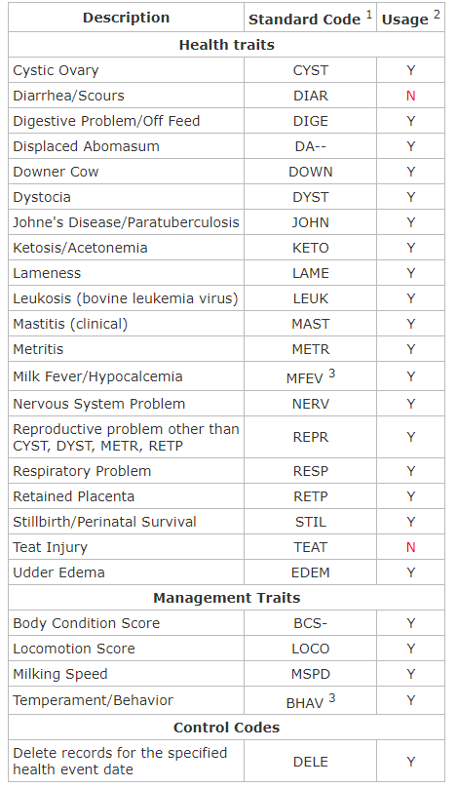
Format 6 (Health Data)
Developed in 2008, and revised in 2017 and 2025 (Cole et al., 2008)
Codes for 20 health traits and 4 management traits
National evaluations for 6 cow health traits
  DA, MFEV, KETO, MAST, METR, RETP
  Holstein (2018), Jersey (2020), and Brown Swiss (2022)
Notes:
A key limitation in developing direct genetic measures for health traits in the U.S. has been the lack of a centralized national health data collection system. In 2008, the Animal Improvement Program Laboratory (now the Animal Genomics and Improvement Laboratory), in collaboration with industry partners and veterinary experts, developed a standardized health record system. This system was designed to track a wide range of conditions, including clinical mastitis, reproductive issues, metabolic disorders, and injuries and also incorporates four management-related codes: body condition score, locomotion score, temperament, and milking speed. It is compatible with existing data formats: lactation record (Format 4) and reproductive record (Format 5).
The first 100 bytes of each health record follow the structure used by other formats with key identification details such as animal ID, sire and dam ID, herd number, and calving date. After this section, each record can include up to 20 individual segments, with each segment representing a reported health event. These segments provide the standardized health code, the date of the event, and specific details relevant to that event.

Slide 4
Objectives
Develop a comprehensive national genetic evaluation system for dairy calf health traits using producer-recorded health event data (Format 6)
Identify genetic markers associated with key health traits in dairy calves and their possible inclusion in genomic marker panel
Notes:
secondary objectives are to identify genetic markers associated with key health traits in dairy calves and their possible inclusion in genomic marker panel,
promote the adoption of genetic evaluation in breeding programs to improve calf health, and continuous improvement of genetic model and phenotypic data collection.

Slide 5
Materials and methods

Slide 6
Phenotypes and heritability estimates
Binary trait: 0 (diseased) and 100 (healthy)
Most data are from Holstein and Jersey (94.5%)
Higher incidence of both DIA and RSP in JE than HO
  DIA: 12.8% in HO vs. 17.2 in JE
  RSP: 13.5 in HO vs. 21.2 in JE
Heritability estimates (all-breed model)
  DIA: 0.026
  RSP: 0.022

Slide 7
Data Growth: 2024 vs 2026
OVERALL GROWTH
YEAR-ON-YEAR GROWTH BY TRAIT
2024 TOTAL
2026 TOTAL
DIA
RSP
889,343
1,551,866
+74.5%
207,602 → 275,451
681,741 → 1,276,415
DIA + RSP combined
DIA + RSP combined
+662,523 records
+32.7%
+87.2%
+67,849 records
+594,674 records
TOTAL RECORD COMPOSITION BY YEAR
DIA diseased
DIA healthy
RSP diseased
RSP healthy
2026
37K
238K
186K
1,090K
2024
30K
178K
109K
572K
Healthy control pool grew faster than cases in both traits
Larger increase in records for HO, which has lower prevalence than JE for both traits
DISEASE PREVALENCE
DIA 2024
DIA 2026
RSP 2024
RSP 2026
14.46%
13.48%
16.05%
14.59%
30,010 disease cases
37,132 cases −0.98 pp
109,412 disease cases
186,261 cases −1.46 pp
M. Neupane (2026)

Slide 8
DIA - Healthy
DIA - Diseased
RSP - Healthy
RSP - Diseased
n = 1,551,866 records
1200K
RSP: 13.48%
1000K
800K
600K
400K
DIA: 12.84%
RSP: 21.24%
200K
RSP: 16.87%
DIA: 17.22%
DIA: 7.79%
0
HO
JE
OTHERS
HO - Holstein
JE - Jersey
OTHERS - Other breeds
DIAR Diseased
27,111
12.84%
DIAR Diseased
9,144
17.22%
DIAR Diseased
877
7.79%
DIAR Healthy
183,989
87.16%
DIAR Healthy
43,957
82.78%
DIAR Healthy
10,373
92.21%
RESP Diseased
141,947
13.48%
RESP Diseased
31,433
21.24%
RESP Diseased
12,881
16.87%
RESP Healthy
911,133
86.52%
RESP Healthy
116,564
78.76%
RESP Healthy
63,457
83.13%
Total
1,264,180 (81.4%)
Total
201,098 (13.0%)
Total
87,588 (5.6%)

Slide 9
DIA cases by day of age
Days 3–60
TOTAL CASES
PEAK DAY
MEAN ONSET DAY
MEDIAN ONSET DAY
90% OF CASES BY
37,132
Day 9
Day 11.4
Day 10
Day 17
days 3 – 60
4,880 cases
weighted average
50th percentile
33,404 cumulative
Daily cases (n)
Peak: Day 9
5,000
Peak day
High-incidence window (≤ day 17)
Tail (day 18+)
The trait utilizes a calf’s reported first incidence of disease. It does not include all incidences.
4,000
3,000
2,000
1,000
0
Day 10
Day 20
Day 30
Day 40
Day 50
Day 60
Age (days)
Age (days)

Slide 10
RSP cases by day of age
Days 3–365
TOTAL CASES
PEAK DAY
MEAN ONSET DAY
MEDIAN ONSET DAY
90% OF CASES BY
186,261
Day 9
Day 83.0
Day 72
Day 179
days 3 – 365
3,621 cases
weighted average
50th percentile
167,864 cumulative
Daily cases (n)
4,500
Peak day
Early acute (≤ day 17)
Plateau / tail
Secondary rise (day 72–112)
Peak: Day 9
The trait utilizes a calf’s reported first incidence of disease. It does not include all incidences.
3,600
2,700
Secondary rise:
~Day 100
1,800
900
0
Day 50
Day 100
Day 150
Day 200
Day 250
Day 300
Day 365

Slide 11
Seasonality

Slide 12
Data quality control (edits)
Calves in the same herd-year (contemporaries) without the health event of interest were treated as healthy animals
For each event, only the first incident reported is used
Herd-years were required to have a minimum incidence rate of 1% and a maximum rate within 2 SD of mean
Known sire identification was required
Notes:
Producer recorded data are noisy, messy, and incomplete
To account for underreporting or data errors, disease incidence in each herd-year was required to exceed a minimum threshold of 1% and a fall below a maximum of 2 standard deviations above the mean disease incidence.

Slide 13
Predicted transmitting abilities
PTA were calculated using the animal model: DIA/RSP = HYS + PG + a + e
Covariates were herd-year-season of birth(HYS) and parity of dam (PG)
All-breed model for traditional pedigree-based evaluation and breed-specific (JE and HO) for genomic evaluation
All animals genotyped were imputed to 69,200
markers using Findhap version 3
Notes:
Parity of dam: First parity dam was further divided into three groups (< 22 mo, between 22-25 mo, and > 25 mo) and embryo transferred heifers were recorded as separate group
Only HO and JE have enough genotypic data for genomic evaluations

Slide 14
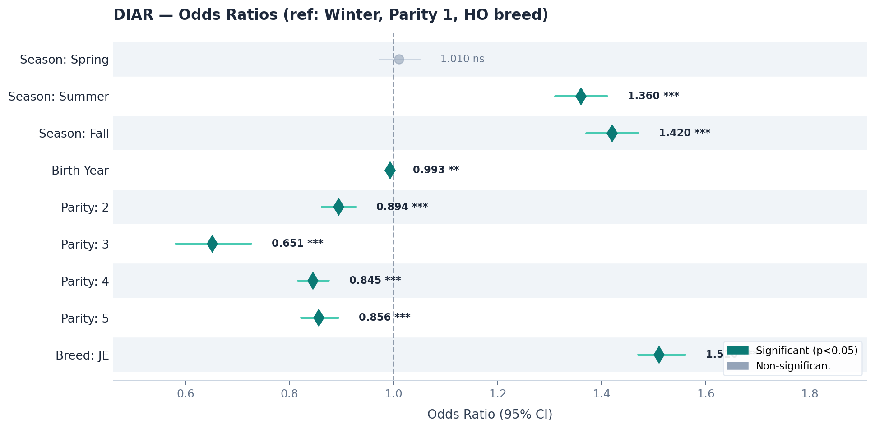
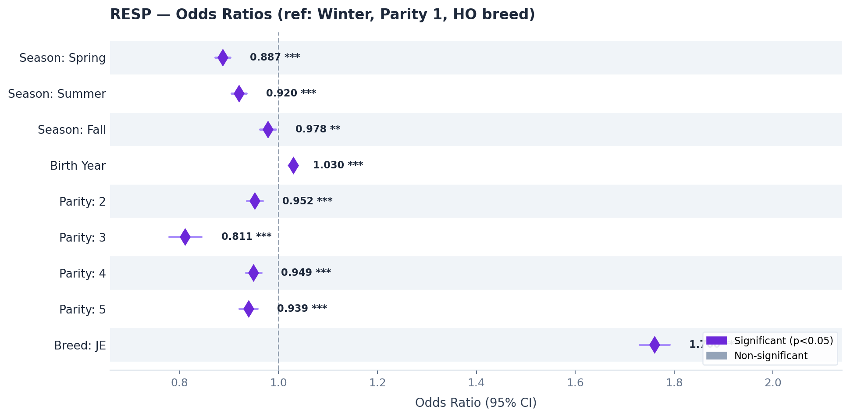
Effect of season of birth, parity of dam, & breed
DIA risk increases in summer/fall while RSP risk is higher in winter
1st parity dam calves have highest odds of disease incidence for both
JE calves show substantially higher odds for both as compared to HO
Notes:
Model: logit(Disease) ~ Season + Birth Year + Parity + Breed
DIAR: Highest incidence in Fall (15.7%) and Summer (14.6%); lowest in Spring (11.5%). Warm/transitional months drive DIAR burden. Winter 11.9%
RESP: Highest incidence in Winter (15.3%); lower in Spring (14.0%) and Summer (14.2%). RESP peaks in cold season - a classic respiratory pattern. Fall 14.9%
So, HYS and parity of dam was included as fixed effects in the model

Slide 15
Traditional and genomic evaluations
Trait | Average genomic PTA ± SD (reliability) |  | Average pedigree PTA ± SD (reliability)
 | Old | Young | Old | Young
DIA - JE | −0.21 ± 0.85 (35) | −0.31 ± 0.84 (32) | −0.20 ± 0.92 (16) | −0.27 ± 0.88 (14)
RSP - JE | −0.16 ± 1.02 (47) | −0.07 ± 1.01 (43) | −0.11 ± 1.08 (22) | −0.01 ± 1.02 (19)
DIA - HO | −0.04 ± 0.73 (51) | −0.08 ± 0.73 (49) | −0.03 ± 0.71 (16) | −0.05 ± 0.68 (13)
RSP - HO | −0.15 ± 0.98 (66) | −0.19 ± 0.96 (65) | −0.12 ± 0.91 (24) | −0.13 ± 0.84 (19)
Notes:
Young animals are those born in 2020 or later, and old animals were born before 2020.

Slide 16
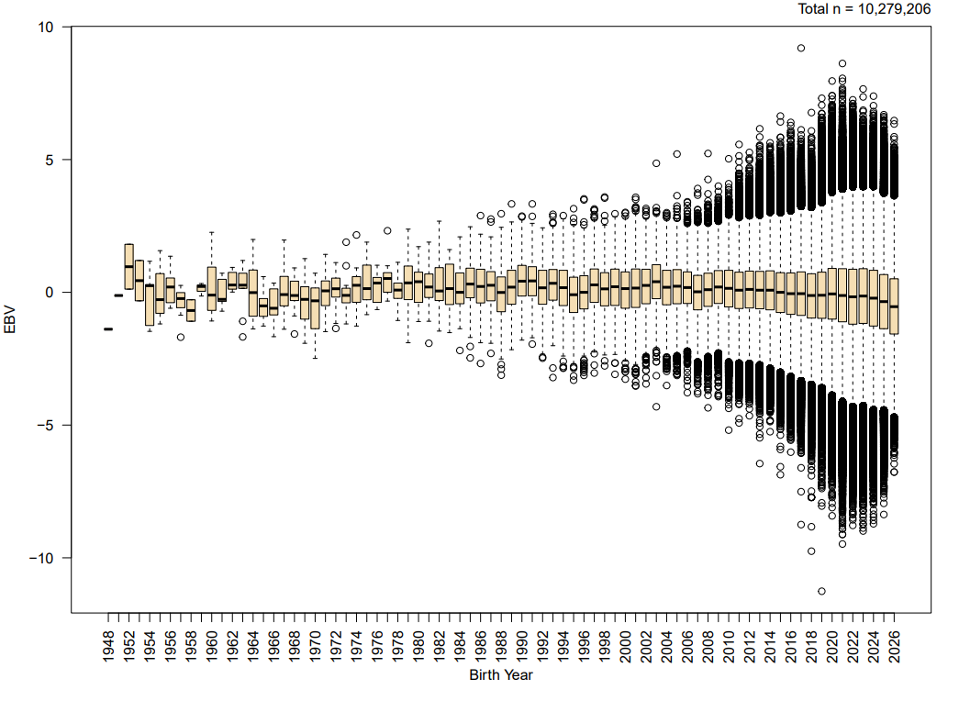
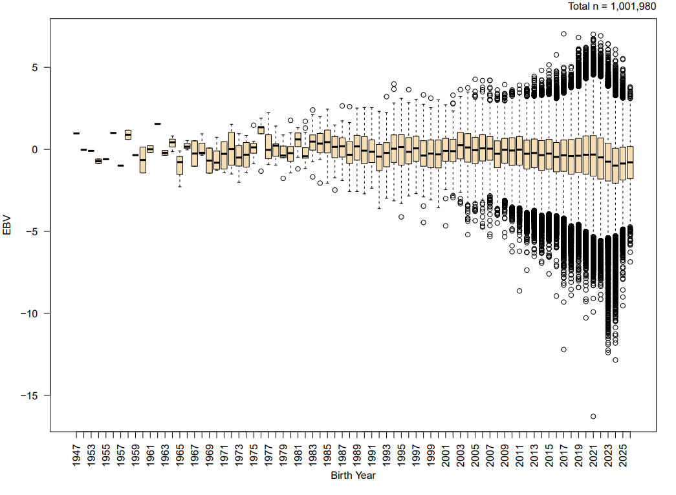
Genomic EBV for DIA by birth year
HO
JE

Slide 17
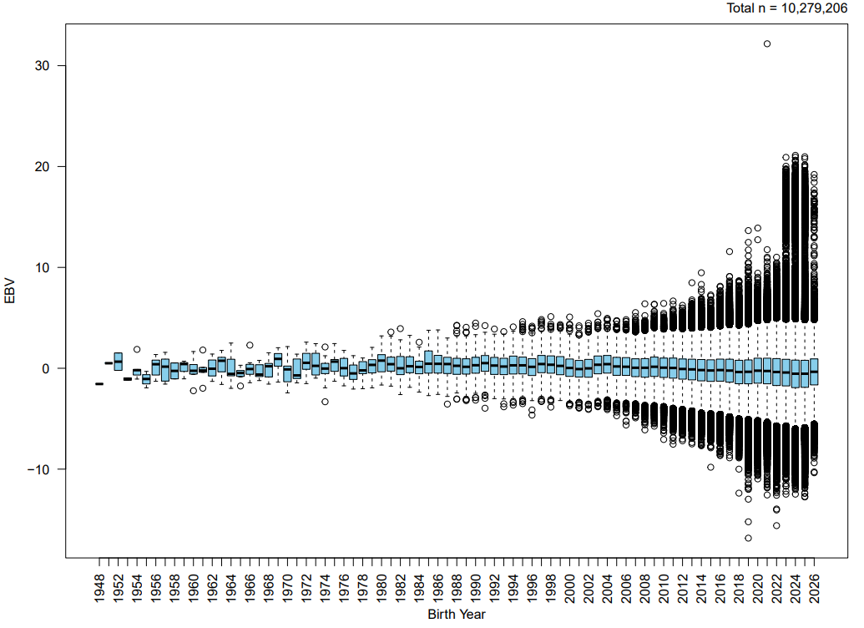
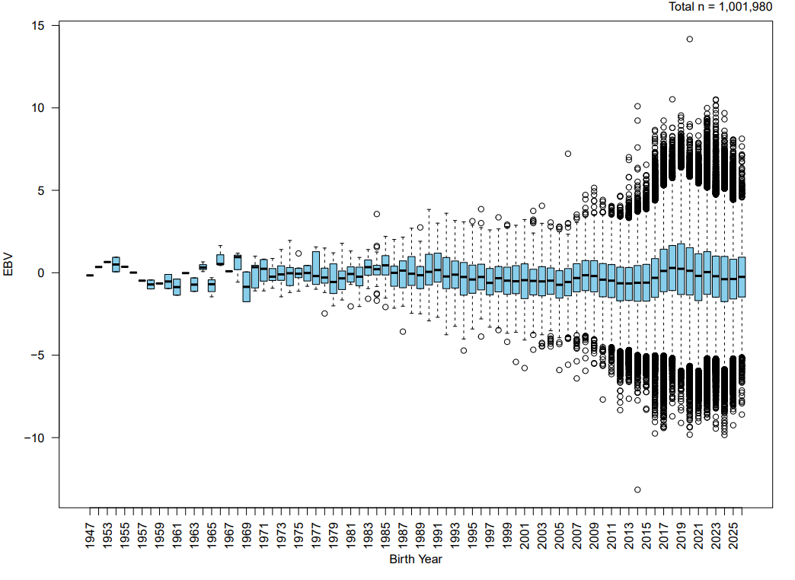
Genomic EBV for RESP by birth year
HO
JE

Slide 18
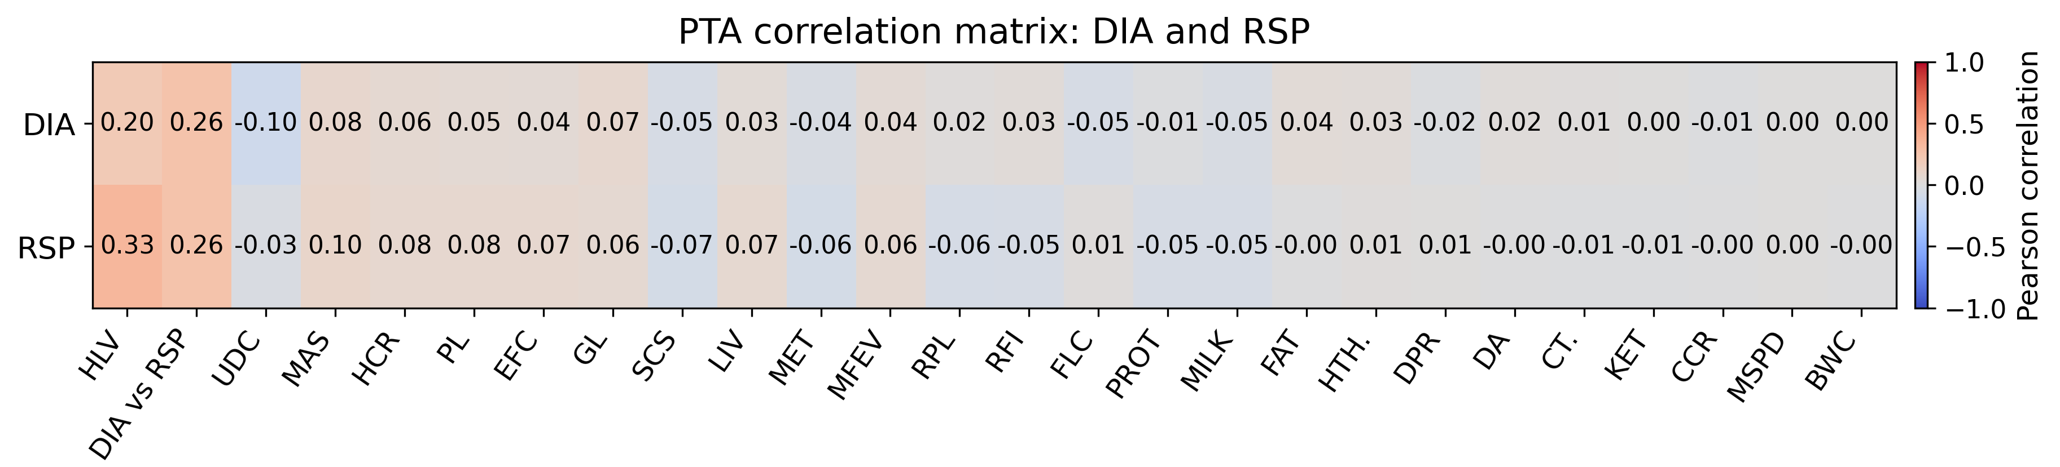
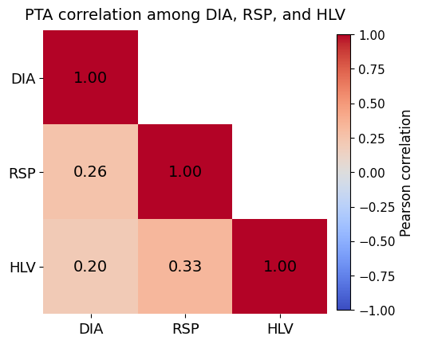
PTA correlations (5,971 high-REL HO bulls)
Notes:
* 5,971 HO high reliability bulls were used for PTA correlations with 25 NM traits.

Slide 19
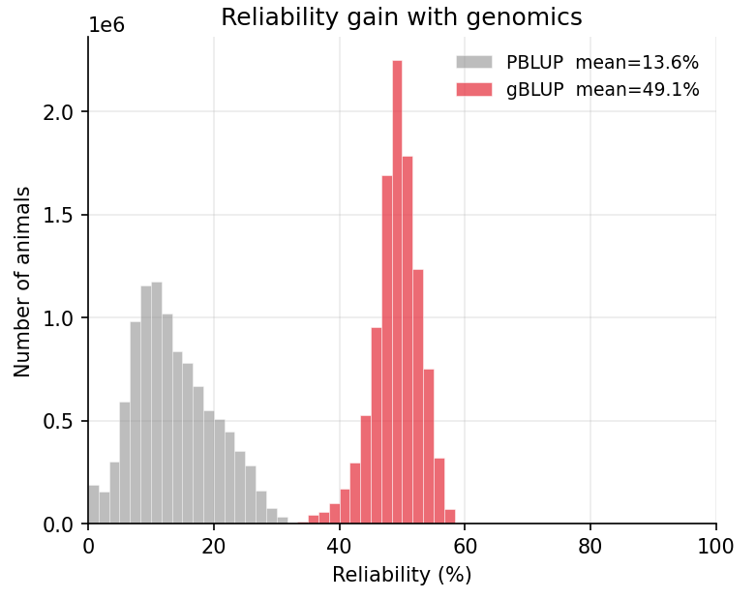
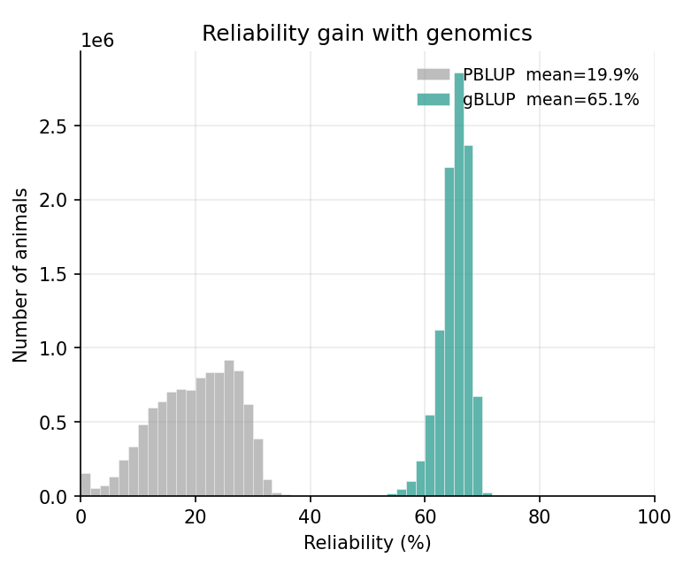
REL gain with genomics for Holstein
DIA
RSP
Notes:
Shift in the reliability of animals comparing traditional evaluations vs genomic evaluations

Slide 20
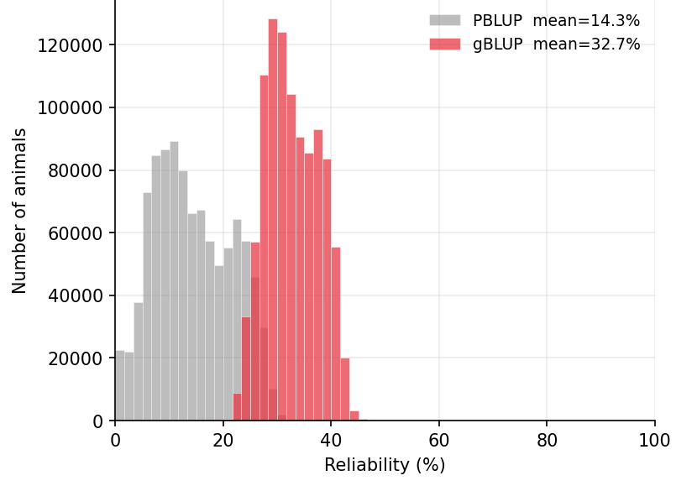
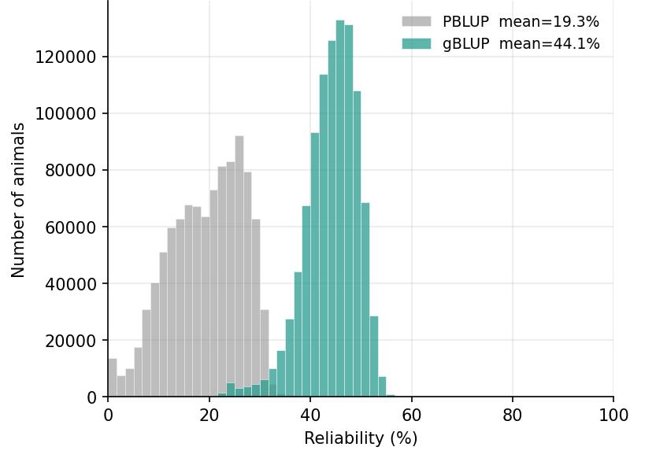
REL gain with genomics for Jersey
DIA
RSP
Notes:
Shift in the reliability of animals comparing traditional evaluations vs genomic evaluations

Slide 21
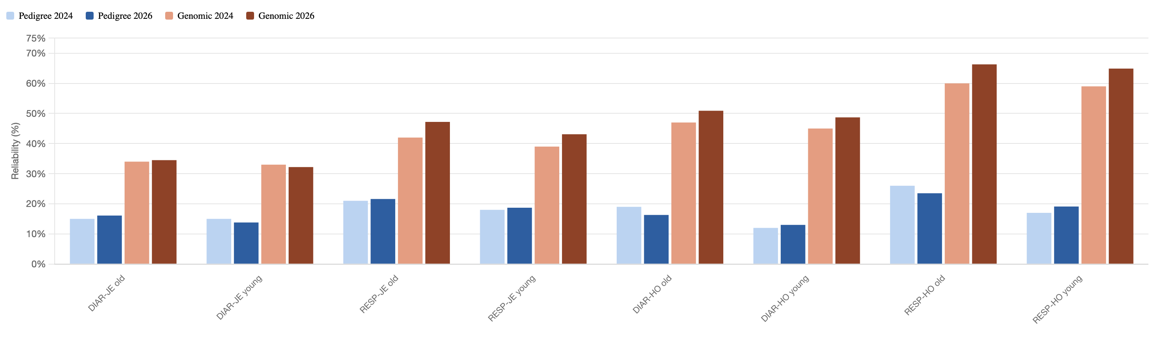
Gain in reliability with more data
Genomic reliability rose sharply for almost all ages, traits and breeds, traditional reliability stayed close to the 2024 baseline
More reliability gain in HO genomic evaluation with more new data
Average genomic reliability gain was ~6 points whereas average pedigree gain was ~0.3 points
Notes:
Comparison of 2024 and 2026 data

Slide 22
Genomewide association studies

Slide 23
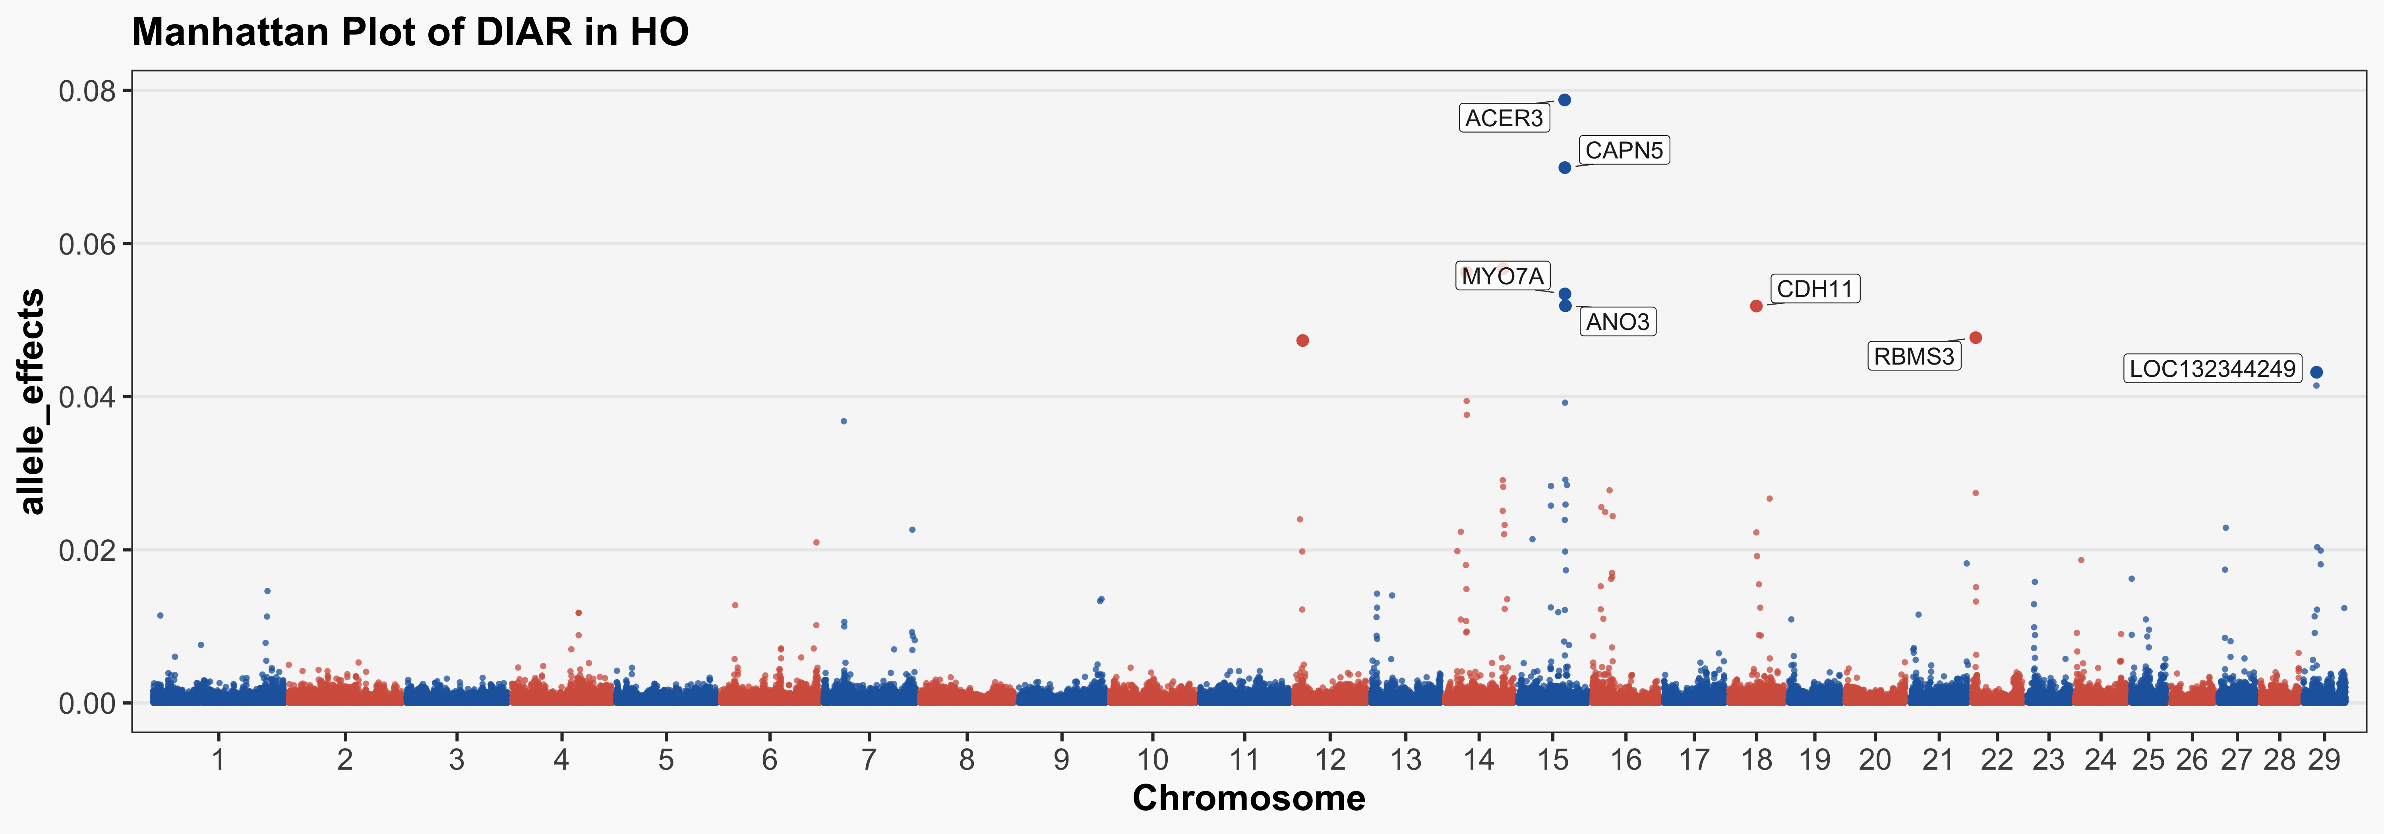
Diarrhea in Holsteins
ACER3: innate immune function, Acer3 knockout mouse colitis resulted in aggravated diarrhea, rectal bleeding, weight loss, and cytokine storm
ANO3: Epithelial Cl⁻ secretion (ANO3 family, directly proven in secretory diarrhea in mice. (shared w/JE DIAR)
CAPN5: Epithelial barrier, role in E. coli/rotavirus infections

Slide 24
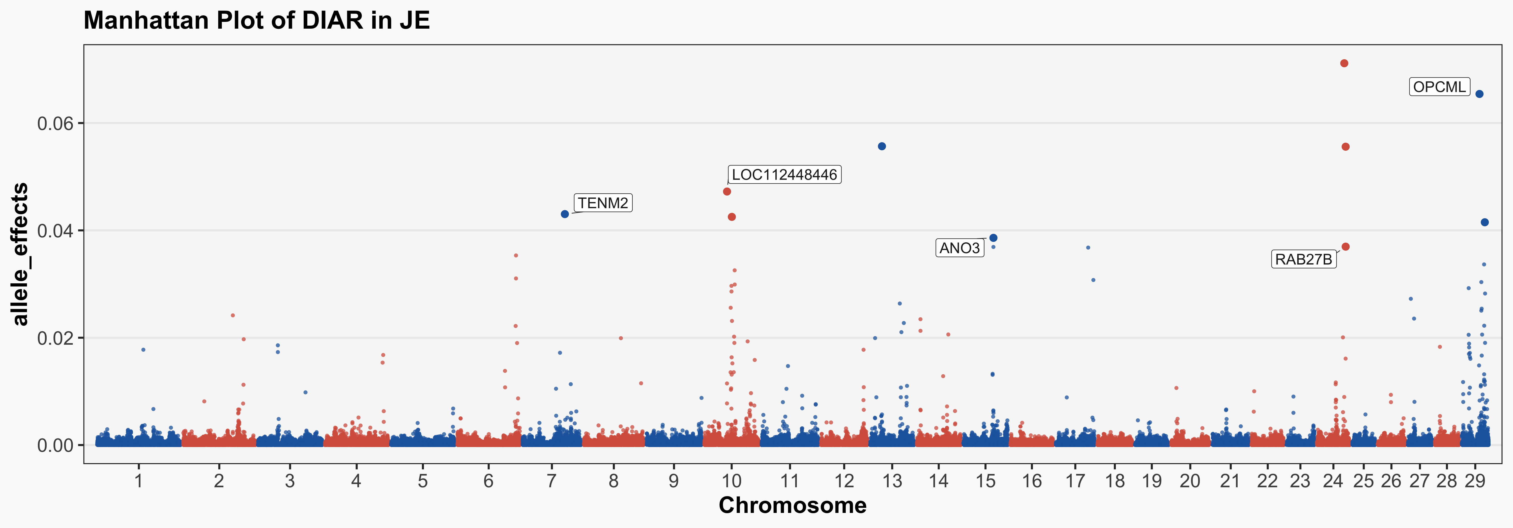
Diarrhea in Jerseys
ANO3: Epithelia Cl-secretion (ANO3 family, directly proven in secretory diarrhea in mice). (Shared w/HO DIA.)
RAB27B: Innate mucosal defense, controls goblet cell MUC2 mucin granule exocytosis forming the protective mucus layer against E. coli K99, rotavirus, Cryptosporidium parvum, and coronavirus
Notes:
SNP to gene mapping of top 10 markers. There are many markers not within genes as expected.

Slide 25
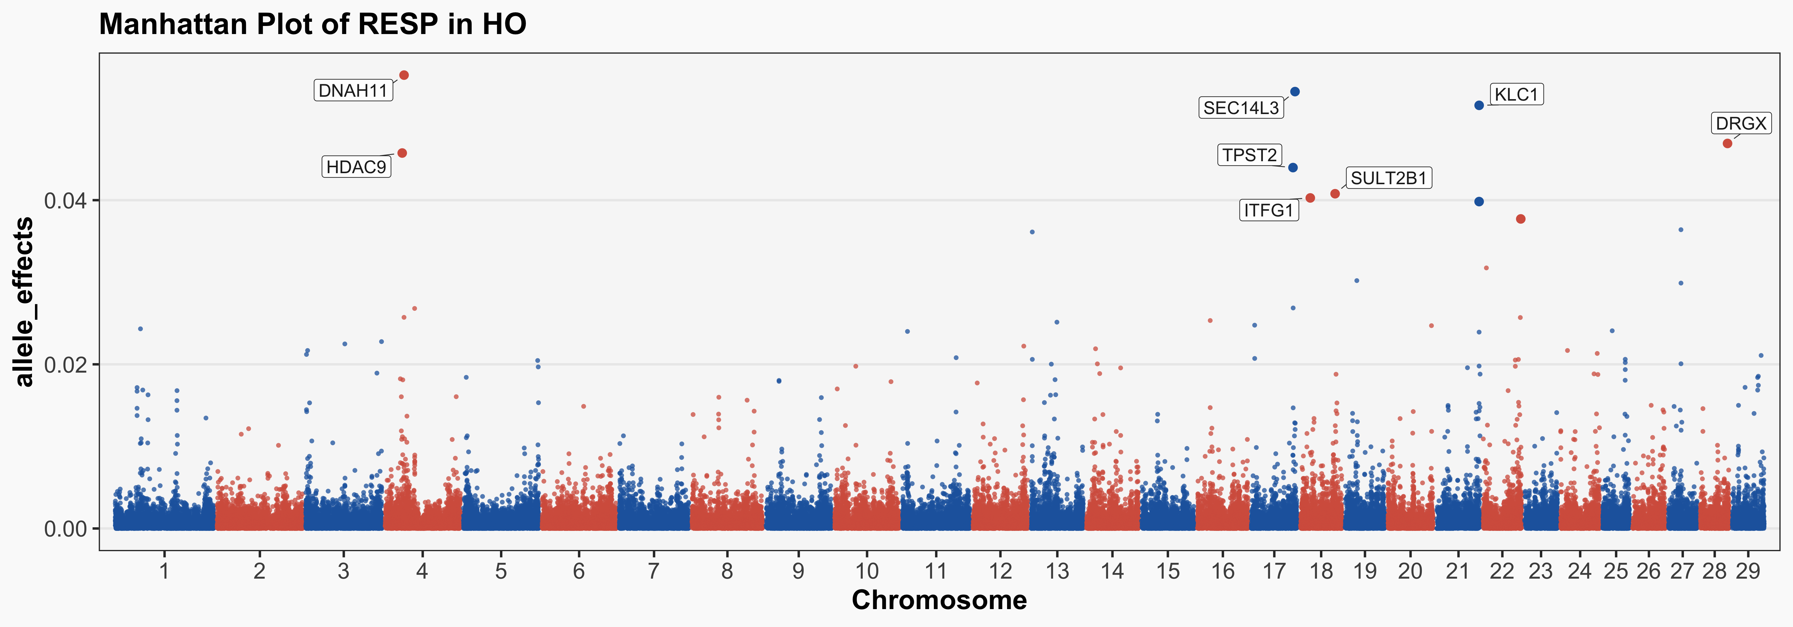
Respiratory disease in Holsteins
DNAH11: Primary Ciliary Dyskinesia (OMIM 611884), 6–9% of all PCD cases
KLC1: regulates cilia length
SEC14L3: surfactant sensor in alveolar cells
Innate metabolic airway defense: HDAC9, ITFG1, and SULT2B1

Slide 26
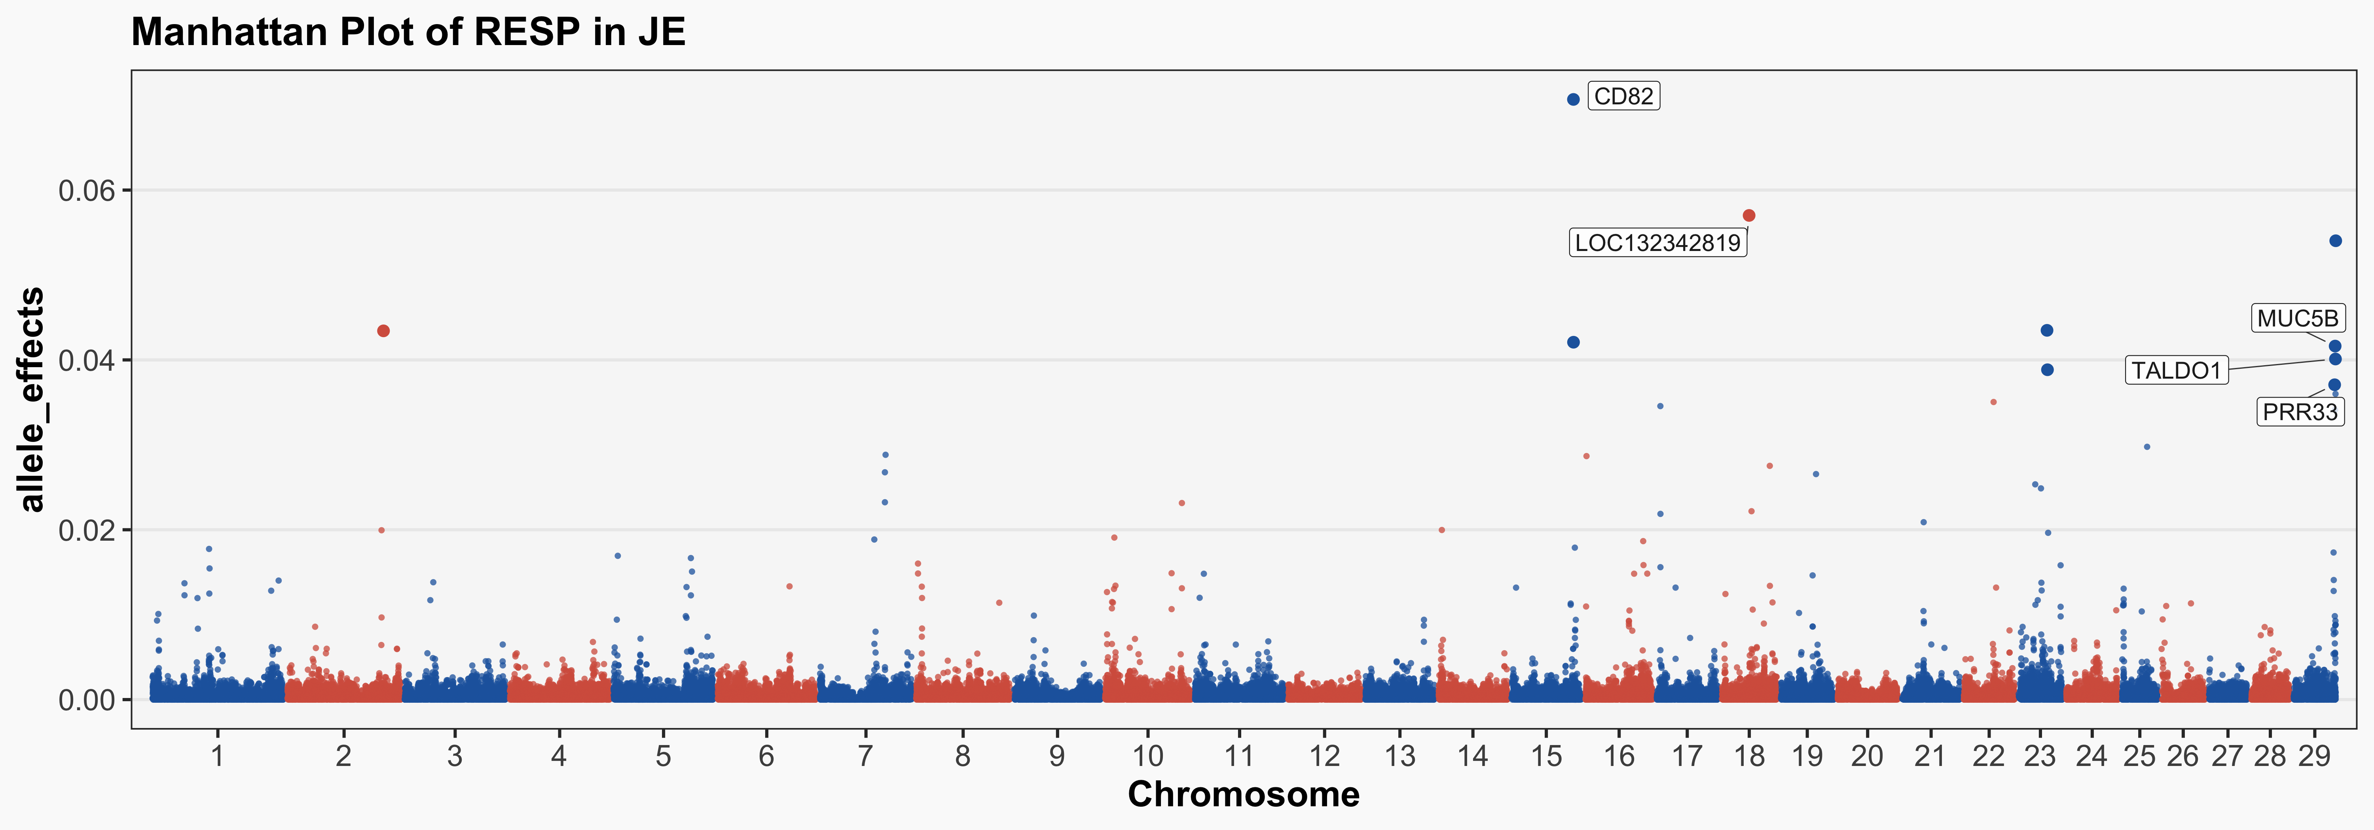
Respiratory disease in Jerseys
CD82: organizes MHC-II antigen presentation machinery
MUC5B: primary component of the mucociliary clearance mesh trapping BRSV, BHV-1, and bacteria

Slide 27
Overlapping markers across traits and breeds
Chr | Position (bp) | Overlap type | Overlap pair
1 | 8,219,111 | Within-breed | JE hliv / JE resp
6 | 114,336,452 | Cross-breed | JE diar / HO diar
8 | 87,844,319 | Within-breed | HO hliv / HO resp
8 | 99,930,691 | Within-breed | JE hliv / JE resp
12 | 9,904,786 | Cross-breed | JE hliv / HO hliv
13 | 7,528,914 | Within-breed | HO hliv / HO diar
14 | 26,012,359 | Within-breed | HO diar / HO resp
15 | 56,550,258 | Cross-breed | JE diar / HO diar
15 | 56,814,315 | Within-breed | HO hliv / HO diar
15 | 57,092,941 | Cross-breed | JE diar / HO diar
15 | 57,727,465 | Cross-breed | JE hliv / HO diar
16 | 1,370,547 | Within-breed | JE hliv / JE resp
21 | 68,223,588 | Within-breed | HO hliv / HO resp
21 | 68,239,476 | Within-breed | HO diar / HO resp
Chr | Position (bp) | Overlap type | Overlap pair
21 | 68,286,885 | Within-breed | HO diar / HO resp
21 | 69,778,711 | Within-breed | HO diar / HO resp
22 | 4,099,178 | Cross-breed | JE diar / HO diar
23 | 9,283,144 | Cross-breed | HO diar / JE resp
23 | 26,926,436 | Cross-breed | HO hliv / JE resp
23 | 27,774,805 | Cross-breed | HO hliv / JE resp
23 | 28,560,191 | Cross-breed | HO hliv / JE resp
23 | 50,536,890 | Within-breed | JE hliv / JE resp
23 | 50,577,723 | Within-breed | JE hliv / JE resp
24 | 55,228,382 | Within-breed | HO hliv / HO diar
25 | 35,652,889 | Within-breed | HO hliv / HO resp
25 | 35,685,435 | Within-breed | HO hliv / HO resp
29 | 50,217,955 | Within-breed | JE hliv / JE resp
31 | 14,619,285 | Cross-breed | HO diar / JE resp

Slide 28
Discussion and conclusions

Slide 29
Economics of calf disease
Treatment costs for diarrhea average $25 per calf (Cangiano, 2023)
Respiratory issues average $40 per calf (Dubrovsky et al., 2020; Elmore and Chibisa, 2023)
Direct and indirect costs of respiratory illnesses range from $200 to $600 per animal, and digestive issues range between $100 and $500 (Elmore and Chibisa, 2023; Lynch et al., 2024)
Most indirect costs are already factored into other traits

Slide 30
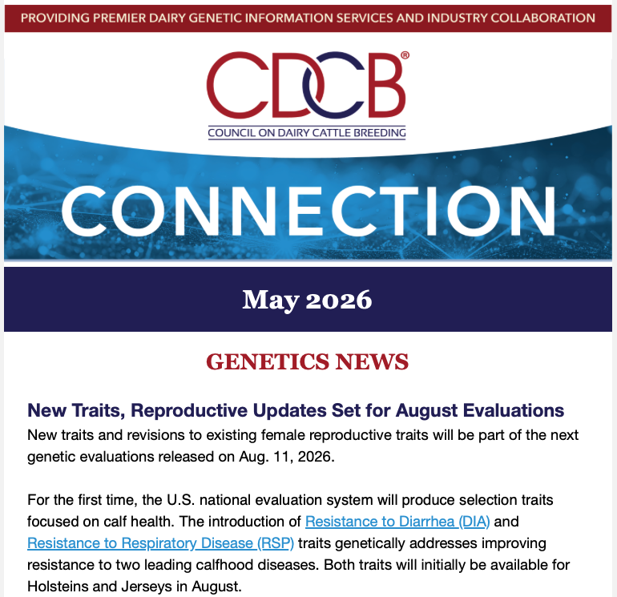

Scan for more resources or to sign up for the CDCB Connection!

Slide 31
Conclusions
National genetic evaluations will provide dairy producers with tools to enhance calf health through selective breeding
Several genomic regions affecting calf health and livability have been identified and warrant further investigation
Selection for healthy calves will contribute to greater profitability and sustainability of herds
Genomic evaluations will be published for US Holstein and
Jersey cattle beginning in August 2026

Slide 32
Acknowledgments
While the Council on Dairy Cattle Breeding (CDCB) offers data stewardship within the National Cooperator Database, sole ownership and rights pertaining thereto remain with the producer. CDCB thanks U.S. dairy producers for sharing their data for research use and industry collaborators for data movement to support this work as well.
The Cooperative Dairy DNA Repository (Verona, WI) is acknowledged for providing genotypes used in this study.

Slide 33
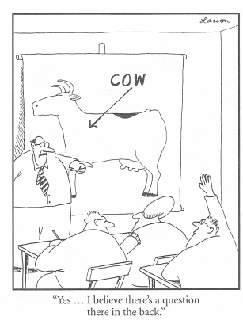
Questions?
Thank you for your attention!
john.cole@uscdcb.com

